Slide 1
M2
The UN Reform and the UNSDCF

Slide 2
Module Objectives
Be aware of the key dimensions of the UN Reform and its implication at the country level;
Position the UNSDCF as a means to ensure demand-driven, integrated, and transformative UN support to countries for delivering on the 2030 Agenda;
See the UN Reform, and the UNSDCF therein, as an opportunity to address gender equality and women’s empowerment;
Refer to gender equality as one of the programming principles guiding the new UNSDCF
Notes:
At the end of this module, participants are expected to…
Explain that the objectives detailed here refer to both this and the following presentation which will illustrate the GEWE dimension of the UN Reform.
Clarify that the purpose of this presentation is not to go through the UN Reform in details, but rather to recall those aspects that are particularly relevant in relation to the UNSDCF and the integration of GEWE therein.

Slide 3
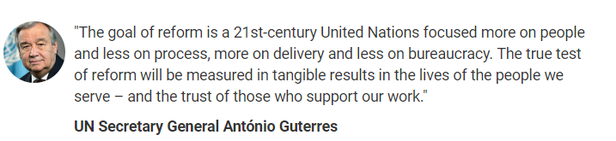
Notes:
Since the beginning of its mandate in January 2017, the UN Secretary-General has made proposals to reform the United Nations. These his remarks at the UN Reform event in September 2017.
The Reform responds to specific requests from the 2016 Quadrennial Comprehensive Policy Review (QCPR), which is the mechanism through which the General Assembly assesses the effectiveness, efficiency, coherence and impact of UN operational activities for development, for the UN to be fit for purpose to deliver on the 2030 Agenda.
Though this is not the first Reform in the history of the UN, it is unparalleled in its scope, and it certainly benefits from strong leadership and unanimous support from Member States.

Slide 4



Three Reform Tracks
Development
System Reform
Management
Reform
Peace and
Security Reform
Position sustainable development at the heart of UN’s work, with the 2030 Agenda as our imperative for change
Recalibrate the Secretariat’s management framework to enable and support action, especially in the field
Improve the structure and operation of the peace and security pillar in UN HQ to better prevent and alleviate crises
“Repositioning the UN
Development system”
“Shifting the manage-ment paradigm”
“Peace and Security
Architecture”
Notes:
The Reform positions sustainable development at the heart of the UN’s work, with the 2030 Agenda as the imperative for change.
The UNDS repositioning is part of a wider set of changes in the UN system. The three streams that are undergoing sweeping changes are: development, management, and peace and security.
Overall, the purpose is to be able to deliver on the 2030 Agenda.

Slide 5
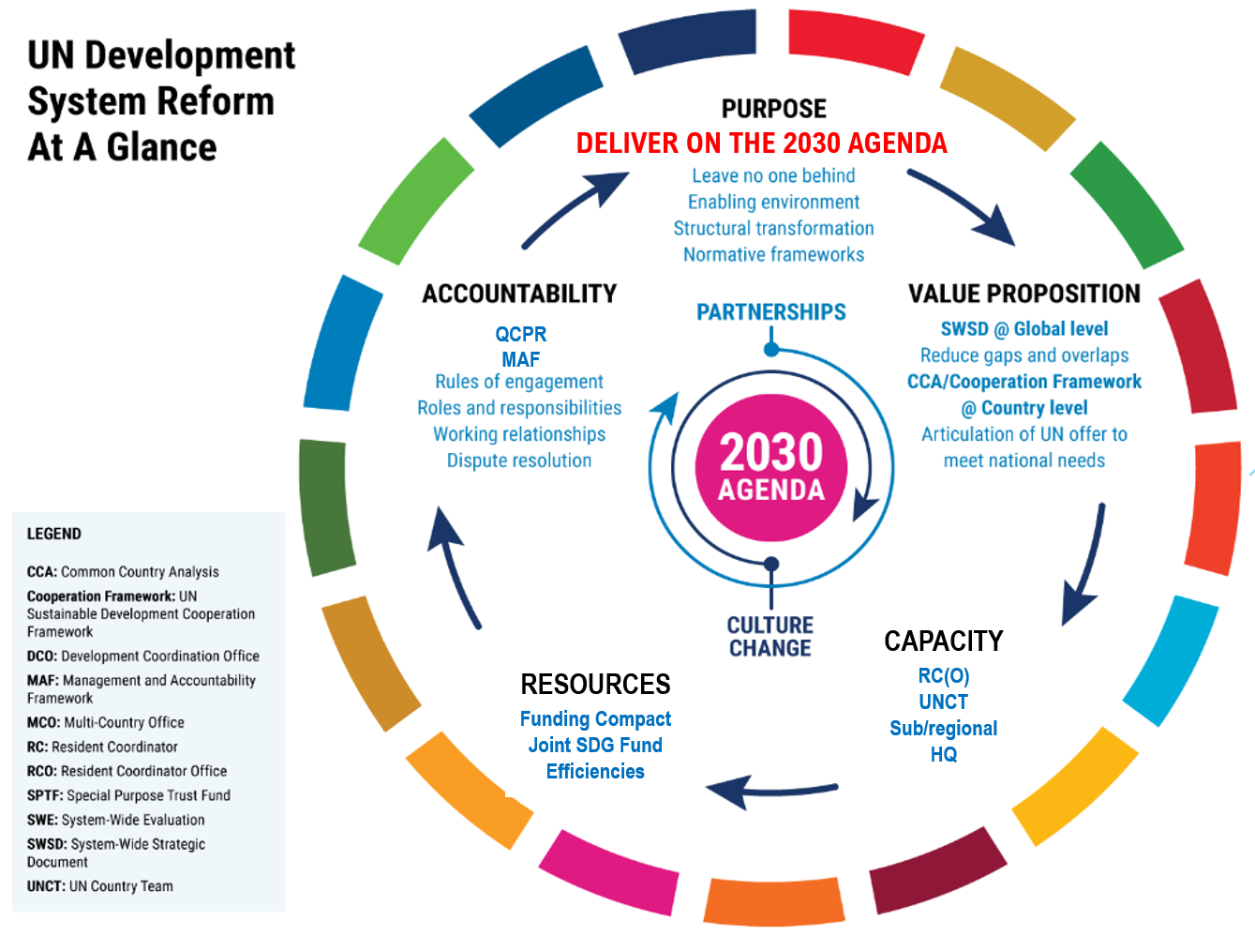
DELIVER ON THE 2030 AGENDA
QCPR
MAF
CAPACITY
RC(O)
UNCT
Sub/regional
HQ
RESOURCES
Funding Compact
Joint SDG Fund
Efficiencies
Notes:
The UNDS repositioning respond directly to the paradigm shift ushered in by the 2030 Agenda and as such applies universally – to all entities of the UN development system and all UN country teams. It also seeks to address structural challenges in coordination mechanisms and mindsets, for a truly transformational impact and one UN response beyond mandates.
The reform fundamentally shifts the development system to a needs-driven approach. All elements are inter-linked and focus on a UN offer to countries that is derived from a single Common Country Analysis with data that can inform national plans and identify national needs.

Slide 6
Value Proposition
System-Wide Strategic Document
UN Cooperation Framework
Demand-driven & open Integrated Transformative
Notes:
The 2019 UN System-Wide Strategic Document (SWSD) to support the implementation of the 2030 Agenda for Sustainable Development articulates the collective identity, comparative advantages, and transformative ambition of the UNDS and commits the UNDS to a more demand driven, integrated, and transformative response.
Of relevance, it guides UN global, regional and country-level development plans, programmes and operations to be reflected in each Cooperation Framework.
Let’s just focus a bit more on the transformative aspect for its relevance in relation to GEWE:
The 2030 Agenda requires nothing less than a UNDS offer that reflects a truly, common transformative purpose.
UNDS support will reflect three integrating approaches:
1. Accelerate structural transformations that place countries on an inclusive and equitable sustainable development trajectory, by mitigating, adapting or capitalizing on far-reaching trends such as: growing inequalities, new trade and financial patterns, climate change and environment sustainability, the future of jobs, urbanization, and the impact of new technologies in all spheres of life.
2. Identify options and implementation of actions designed to Leave No One Behind, as an indispensable dimension of inclusive structural transformation.
3. Consider the enabling environment and what is needed to sustain inclusive structural transformations in the essential dimensions of people/leadership/human resources, institutions and partnerships.

Slide 7
Capacity
Resident Coordinator (Office)
UNCT
Multi-country/ cross-border
Regional
HQ
Notes:
Among the revised capacities needed to sustain the reform, a new generation of UN Country Teams: the composition, roles and profiles of which are tailored to the context, and that deliver shared results.
In this, the redesigned UN Sustainable Development Cooperation Framework is central! It becomes the main strategic instrument to respond to national needs and priorities. You’ll probably all recognize the sentiments expressed by the SG about UNDAFs: “Most of them, not all, were cut-and-paste. Agencies present their papers, and everything will be put together and this will be delivered as the UNDAF. No way to avoid duplication and overlaps. Agencies do different things funded by different entities, but in the end a waste of money.”

Slide 8
The UNSDCF
Notes:
The General Assembly resolution 72/279 (2018) on repositioning of the UN elevated the new Cooperation Framework to the most important instrument for planning and implementation of the UN development activities at country level in support of the implementation of the 2030 Agenda for Sustainable Development.
It is a partnership compact between the UN, governments and other stakeholders to improve people’s lives while leaving no one behind.
Cooperation Framework serves as a core accountability tool between the UN Country Team (UNCT) and the host government, as well as between and among UNCT members for collectively-owned development results.

Slide 9
Revitalized, strategic, flexible and results- and action-oriented UNDAF* (now UNSDCF) is the most important instrument for the planning and implementation of the UN development activities in each country in support of the implementation of the 2030 Agenda for Sustainable Development
UN GA Resolution A/RES/72/279
Notes:
Cooperation Framework is a manifestation of a UN development system that is agile, cohesive, and responsive to a country’s priorities and people’s needs.
It is the UN’s collective response to help countries address national priorities and gaps in their pathways towards meeting the SDGs.
The new Cooperation Frameworks should be strategic, demand-driven, and transformative.

Slide 10
The UNSDCF cycle
Analysis
Development of the Cooperation Framework
Implementation
Results
National Development Plans
Common Country Analysis
Cooperation Framework Design
UNCT Configuration
Cooperation Framework signed
Funding Framework and SDG Financing Strategy
Agency Specific-Documents
Joint Workplans
Annual Review + One UN Country Results Report
Other Analytic Inputs
Feedback Loop into new cycle
Evaluation Management Response
Cooperation Framework Evaluation
Notes:
The diagram above illustrates the key steps of the UNSDCF process. The CF is intended as the core instrument for UNCTs as they plan, finance, deliver and evaluate their support to countries in achieving the Sustainable Development Goals (SDGs), typically over a five-year cycle, though the period is generally flexible to allow alignment to national cycles and ensure the UN offer remains relevant to the evolving context.
The estimated timeframe for the development of the framework on the other side could vary between 6 and 9 month.
Rarely is a Cooperation Framework setting out an entirely new agenda. More typically, it contains both familiar results and the unfinished business of the previous Cooperation Framework, as well as new support areas.

Slide 11
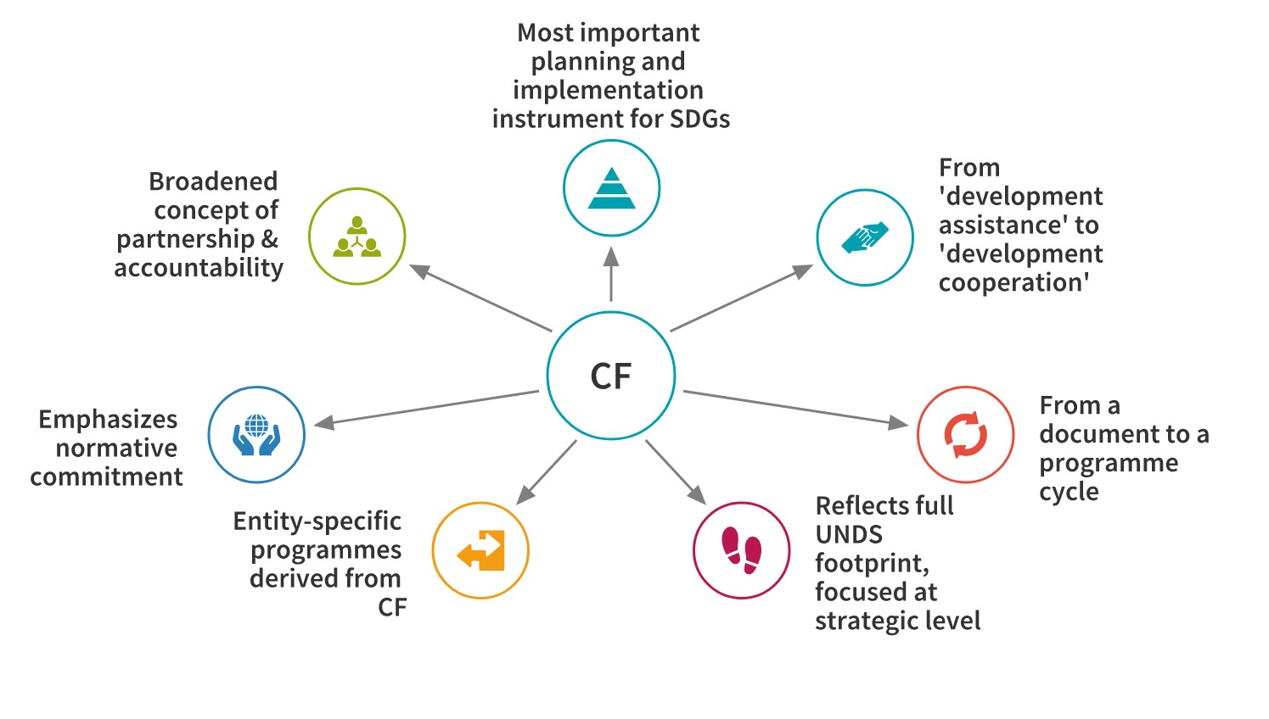
New Features
Notes:
The Cooperation Framework now guides the entire programme cycle, driving planning, implementation, monitoring, reporting and evaluation of collective UN support for achieving the 2030 Agenda.
The Cooperation Framework’s expanded notion of partnerships offers a powerful opportunity to engage with relevant stakeholders in the UN CCA process through continuous and inclusive dialogue to address complex issues, such as inequality and exclusion, among others.
The CCA, and in general the whole analytical phase, is no longer a one-off event, but a real time core analytical function that should ideally inform the whole duration of the CF.

Slide 12
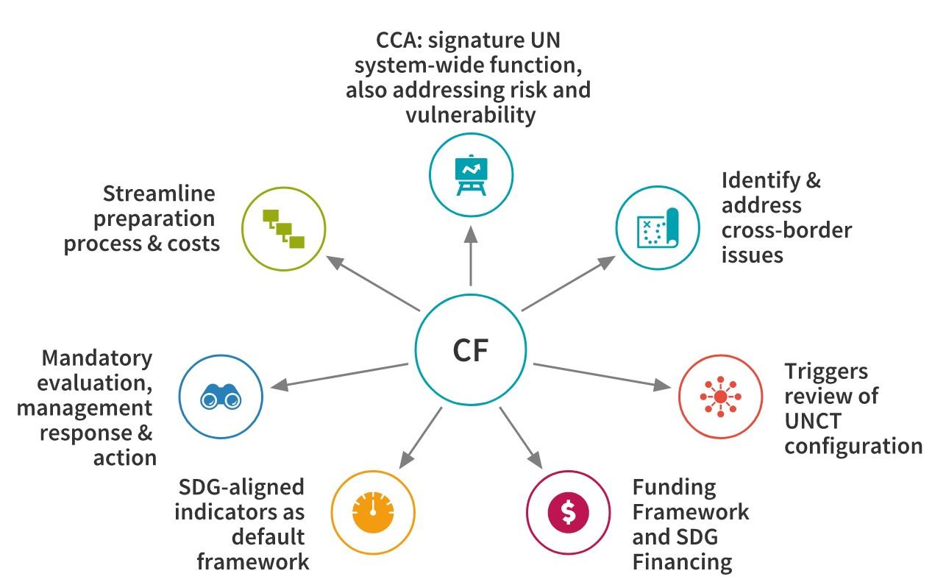
Notes:
The SDG targets and indicators are now “the default monitoring framework,” informed by country-defined and disaggregated baselines. These indicators are to be tracked online through UN INFO at country level.
A new step, which did not exist in the previous UNDAF, is the review of the UNCT configuration (second step of the development phase), which is meant to ensure the UN country team has the capacity to deliver on stipulated commitments.
Budgeting is now placed within the larger context of SDG financing
The Cooperation Framework is strengthened by the Management and Accountability Framework which articulates how all members of the development system will work together and deliver on their obligations – both to their respective agency or programme and also to collective results in-country.

Slide 13

Questions?
Photo credit: www.flickr.com
Notes:
The Cooperation Framework is designed to be the primary instrument for planning and implementation of the UN development activities at country level in support of the implementation of the 2030 Agenda for Sustainable Development. As such, the framework captures country needs and tailors the UN development system (UNDS) response and presence on the ground.

