Slide 1
M3
The Normative Framework on GEWE
Notes:
Explain that after having briefly introduced the UN Reform and the GEWE dimension therein, it is now time to take a step back and consider the framework that provides the rationale for a gender-responsive UNSDCF engagement.
The sessions that follow intend to walk participants through the key set of norms, standards and principles underlying our work on GEWE. In addition to international agreements there are women’s rights frameworks such as the Beijing Platform for Action that apply to Governments, organizations, and the international community and UN resolutions that set the obligations of all UN agencies to include GEWE into their work.
A good source is the Global Accountability Framework on Gender Equality and Women’s Empowerment Note that this highlights the UNCT-SWAP GE Scorecard; QCPR and successive ECOSOC resolutions related to gender mainstreaming.

Slide 2
Module Objectives
Understand the rationale behind the comprehensive integration of the gender into key phases of sustainable development work;
Recall the basic concepts and international frameworks that underpin gender equality and the empowerment of women;
Apply gender-related terms and concepts appropriately;
Understand the centrality of gender to delivering on the promise of the 2030 Agenda and its linkages with the LNOB principle.
Notes:
At the end of this module participants are expected to…
Again reiterate that the objective is not to turn participants into experts on GEWE, but to ensure a common understanding of existing frameworks and terms to effectively contribute to gender mainstreaming in the UNSDCF.
More specifically, this presentation is meant to remind participants of the standards and tools that exist at the global level for gender mainstreaming.

Slide 3
Normative Framework
International legal framework
UN framework
SDGs
CONTEXTE
Universal declaration CEDAW, Beijing Declaration
GENDER
EQUALITY
ECOSOC, QCPR, UN System wide strategies, UNDS reform, CSW agreed conclusions, and WPS agenda
Accountability :
UN SWAP & Gender score card
Agenda 2030, National Ownership
Notes:
When it comes to GEWE, the overall normative framework is made of the international legal standards and provisions contained in treaties and other universally recognized and adopted documents; the commitments made by the UN on gender equality, and the two accountability systems, the UN SWAP and the UNCT-SWAP Scorecard; and the 2030 Agenda for Sustainable Development.
The confluence of Beijing+25, the Global Review of the UN Resolution 1325 and the new Development Agenda and SDGs all in 2015 provided a unique opportunity to (re)position gender equality and empowerment of women at the heart of the global agenda.

Slide 4
UDHR
Article 1:
“All human beings are born free and equal in dignity and rights”, while
Article 2:
“everyone is entitled to all the rights and freedoms set forth in this Declaration, without distinction of any kind, such as race, colour, sex, language, religion, … birth or other status”
Notes:
The UDHR constitutes the first global expression of rights to which all human beings are inherently entitled to. It acknowledges that men and women are not the same but they have the right to be treated equally and without discrimination.
Article 1 provides the first and most encompassing reference to gender equality: “All human beings are born free and equal in dignity and rights”, while Article 2 specifically states the right to be free of discrimination based on the grounds of sex, among others: “everyone is entitled to all the rights and freedoms set forth in this Declaration, without distinction of any kind, such as race, colour, sex, language, religion, … birth or other status”.

Slide 5

CEDAW
Principle of substantive equality
Principle of non-discrimination
Liability of states
Photo credit: UN Women Ukraine
Notes:
Also known as the bill of rights for women, CEDAW is a dynamic human rights instrument that is exclusively devoted to gender equality. It defines what constitutes discrimination against women (Art. 1) and sets an agenda for states on how to end it and achieve substantive equality. Ask for a volunteer to read the definition aloud.
CEDAW is a normative, legally binding document for states to fulfil, protect and respect women’s human rights, against abuses and violation committed by both state and not state actor(s).
2019 marked 40 years since its adoption by the General Assembly in 1979.
The below link is to a short video that introduces one of the three key principles that underpin the CEDAW, the principle of non-discrimination: https://www.youtube.com/watch?v=OBdDB5PKrmk

Slide 6

Temporary Special Measures
Notes:
CEDAW also contains an evolution of the principle of non-discrimination, recognizing that equal treatment may lead to unequal results and for the first time recognizes the need for special affirmative measures (Art. 4 and General Recommendation 25). These measures are aimed at accelerating de facto equality and shall be discontinued when objectives of equality of opportunity and results have been achieved. A ‘corrective approach’ recognizes the differences, places obligation to correct the environment, makes playing field even, and promote the inclusion of a gender perspective in laws and policies.
The Committee on the Elimination of Discrimination against Women (CEDAW) is the body of experts that monitor the implementation of CEDAW through country reports submitted every four years. UNCT also submits confidential reports to the CEDAW Committee.

Slide 7

The Principle of Equality
Four dimensions:
Redressing disadvantage
Countering stigma, discrimination, prejudice and violence
Transforming social and institutional structures
Facilitating social and political participation
Notes:
The principle of equality is central to all international human rights instruments. Equality however is often generically referred to as equality before the law, or equality of opportunity, without sufficient consideration to the fact that equality of treatment in a context of chronic, deep-rooted disadvantages may simply perpetuate the disadvantage itself (equality of results).
Hence the importance of looking into the four following dimensions:
Redressing existing disadvantages, which may also mean applying different treatment where needed, including extending benefits, incompatible with a levelling down approach.
Counter stigma, prejudice, discrimination and violence.
Transform institutional structures, changes are needed in terms of redistribution of power and resources, and must be structural, not just at the individual levels.
Enhance social and political participation as essential to women’s agency and voice.

Slide 8

Beijing Declaration & Platform for Action
Notes:
Unprecedented gathering from 189 countries for a two week of political debate that produced the most progressive blueprint for advancing women’s rights (1995). The Declaration & Platform for Action constitute a defining and foundational policy framework for the achievement of gender equality, women’s rights and the empowerment of women that is still forward-looking 25 years later.

Slide 9
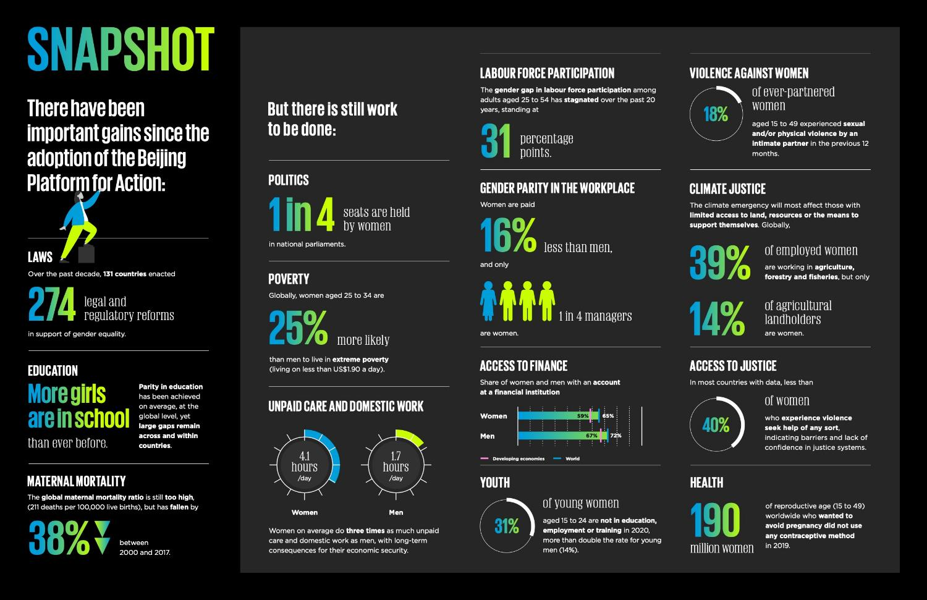
Notes:
2020 is marking the 25th anniversary of the adoption of the Beijing Platform for Action, and the first time progress have been reviewed in light of the 2030 Agenda for Sustainable Development.
Here is a snapshot of the achievements and challenges contained in the report “Gender Equality: Women’s rights in review 25 years after Beijing”, published by UN Women in 2020. https://www.unwomen.org/-/media/headquarters/attachments/sections/library/publications/2020/gender-equality-womens-rights-in-review-en.pdf?la=en&vs=934

Slide 10
A. Gender-related SDG results
Commitment to gender-related SDG results
B. Institutional strengthening to support achievement of results
Policy
Reporting on gender-related results
Leadership
Programmatic results on gender equality and the empowerment of women
Evaluation
Audit
Gender-responsive performance management
Financial resource tracking
Financial resource allocation
Gender architecture
Equal representation of women
Organizational culture
Capacity assessment
Capacity development
Knowledge and Communication
Coherence
UN SWAP 2.0
Notes:
Explain that at the origin of the development of the UNSWAP was the adoption in 2006 of the UN System-wide Policy on Gender Equality, which triggered a series of efforts by the UN, spearheaded by UN WOMEN, for the creation of a system to measure the performance of all UN entities on GEWE.
A first version of the UN System-Wide Action Plan (UN-SWAP) on Gender Equality and the Empowerment of Women (GEEW) was initially adopted in 2012. As of 2018, 66 UN entities were reporting annually through an on-line tool, and for the first time the UN has an overview of gender mainstreaming across the UN system. In 2019 a new version (UN-SWAP 2.0) was released, which accounts also for the status of results of gender-related SDGs. The new framework for implementation is now 2019-2023.
In this slide are all the areas covered by the current UN-SWAP. Of relevance, are the focus on results in relation to the SDGs, and the indicators on leadership and gender parity.
Explain to the participants that given the importance of the UNCT-SWAP Gender Equality Scorecard for them and in the context of the UNSDCF, this will be discussed separately in the following day.

Slide 11
Gender & QCPR
QCPR Resolution 71/243 in 2016:
  recognizes the multiplier effect of gender equality and empowerment of women and girls on economic growth, poverty eradication and sustainable development;
  calls on all UN entities to continue to promote women’s empowerment and gender equality by enhancing gender mainstreaming through the UNSWAP and the Gender Equality Scorecard
  emphases the UNCT-wide gender-responsive performance management and strategic planning; the collection and use of sex-disaggregated data, reporting and resource tracking; and drawing on available gender expertise in the system at all levels, including in UN Women, to assist gender mainstreaming in planning framework
Notes:
Finally, a few notes on the 2016 resolution of the Quadrennial Comprehensive Policy Review, and its multiple references to the importance of gender equality for sustainable development and puts the emphasis on some mechanisms for ensuring gender mainstreaming in planning framework.
The Quadrennial Comprehensive Policy Review (QCPR) is the mechanism through which the General Assembly assesses the effectiveness, efficiency, coherence and impact of UN operational activities for development.
The QCPR resolution (A/RES/67/226) calls upon the UN Development System to draw upon available expertise within the UN system to support gender mainstreaming in programme planning and implementation and to ensure that the principles of gender equality are systematically integrated in all stages of elaboration of UNDAF and other development frameworks.
This was followed in 2018 by GA Resolution on the UN repositioning that was mentioned before.

Slide 12

Questions?
Photo credit: www.flickr.com

