Slide 1
M3
Basic GEWE
Concepts
Notes:
This as the previous session on the normative framework is meant to ensure a common level of understanding among participants about GEWE issues.
Yet, only a selection of key gender terms and definitions will be discussed here among those that are either particularly relevant to the UNSDCF or represent recent evolutions of gender terminology and as such would benefit from some additional explanation.
The UN Women online glossary is good source for more comprehensive list of gender terms.

Slide 2
Gender Mainstreaming
Notes:
For each slide, display it on the screen and ask participants to define the term, and allow a few contributions. Then facilitators provide share the definition.
Gender mainstreaming is the process of assessing the implications for women and men of any planned action, including legislation, policies or programmes, in any area and at all levels. It is a strategy, not an end in itself, for making women's as well as men's concerns and experiences an integral dimension in the design, implementation, monitoring and evaluation of policies and programmes in all political, economic and social spheres so that women and men benefit equally and inequality is not perpetrated. The ultimate goal is to achieve gender equality.
Gender Mainstreaming is enshrined as one of two strategies in the Beijing Declaration and Platform for Action– the other is dedicated programming to advance gender equality and the empowerment of women.

Slide 3
Women’s Empowerment
Notes:
The empowerment of women concerns their gaining power and control over their own lives. It involves awareness-raising, building self-confidence, expansion of choices, increased access to and control over resources and actions to transform the structures and institutions which reinforce and perpetuate gender discrimination and inequality. This implies that to be empowered they must not only have equal capabilities (such as education and health) and equal access to resources and opportunities (such as land and employment), but they must also have the agency to use these rights, capabilities, resources and opportunities to make strategic choices and decisions (such as is provided through leadership opportunities and participation in political institutions).

Slide 4
Intersectionality
Notes:
30 years ago, Kimberlé Crenshaw , a legal scholar and civil-rights activist coined the term “intersectionality” to describe the interplay of different forms of oppression.
First laid out in 1989 in a paper in the University of Chicago Legal Forum titled “Demarginalizing the Intersection of Race and Sex”, the term later caught on and made it into the Oxford English Dictionary in 2015, and in a little less academic way into the Merriam-Webster’s which defines it as: “the complex, cumulative way in which the effects of multiple forms of discrimination (such as racism, sexism, and classism) combine, overlap, or intersect especially in the experiences of marginalized individuals or groups.”
Let’s watch some minutes of a very powerful video on this. https://www.ted.com/talks/kimberle_crenshaw_the_urgency_of_intersectionality The interconnected nature of social categorizations such as race, class, and gender, regarded as creating overlapping and interdependent systems of discrimination or disadvantage; a theoretical approach based on such a premise.

Slide 5
Non-binary
Notes:
Understanding of gender continually evolves. Gender is now increasingly seen along a spectrum rather than limited to the two male or female options. Gender results from the complex interrelationship between the body, one’s identity, and social aspects. A non-binary approach to gender recognizes that wide variations actually exist along a continuum of possibilities that also include transgender, queer, gender non-conforming.

Slide 6
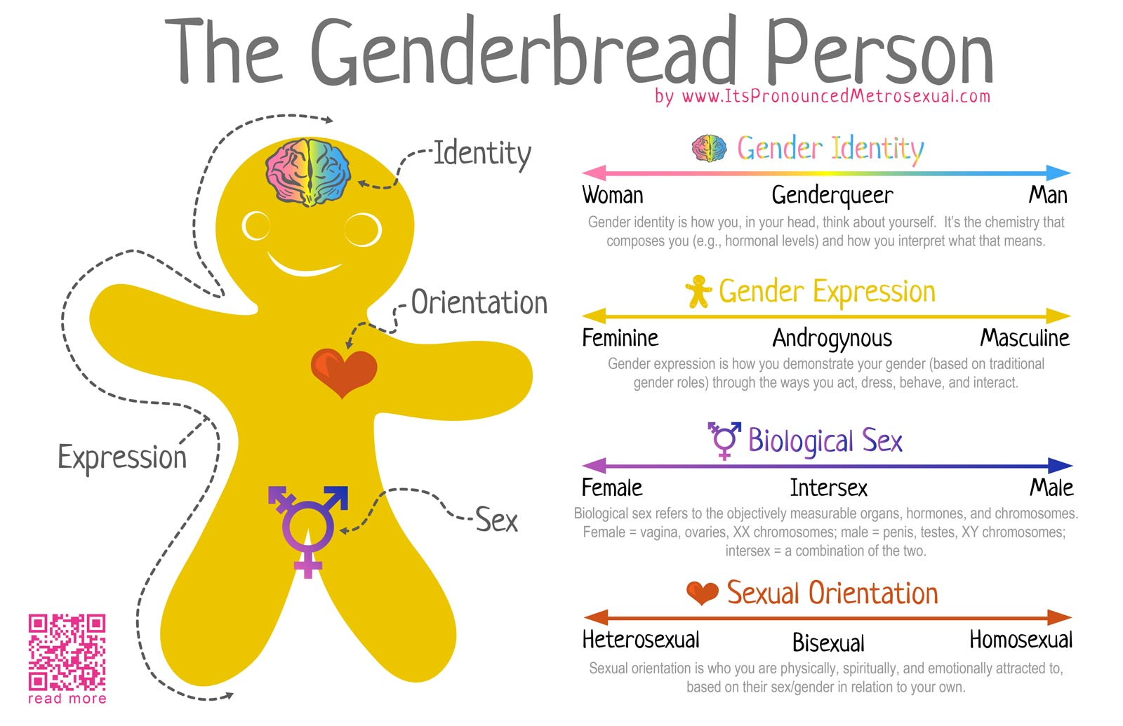
Notes:
Gender identity: Gender identity is our personal experience and naming of our gender, which may or may not correspond to the person’s physiology or designated sex at birth. It includes both the personal sense of the body, which may involve modification of bodily appearance or function by medical, surgical, or other means, and other expressions of gender, including dress, speech, and mannerisms.
Gender expression: Gender expression is the way we communicate our gender to others through things such as clothing, hairstyles, mannerisms, and interaction.
Sexual orientation: Sexual orientation is who you are physically, emotionally and spiritually attracted to based on their sex/gender and in relation to yours. There are three predominant sexual orientations: towards the same sex/gender (homosexuality), towards the opposite sex/gender (heterosexuality) or towards both sexes/genders (bisexuality).
We may assume that individuals who are biologically female or identify with the female gender are automatically attracted only to men. But someone’s biological sex may be female, their gender identity and gender expression could be male, and their sexual orientation could be “gay” or “lesbian” or “bisexual”.
Sexual identity has many levels and is expressed through various continua

Slide 7

Questions?
Photo credit: www.flickr.com

