Slide 1
M3
The 2030 Sustainable Agenda and GEWE
Notes:
Gender equality and the empowerment of women are reflected in all elements of the 2030 Agenda – the declaration, goals, targets and indicators, means of implementation, global partnership, and follow-up and review – mainstreamed through the entire agenda.

Slide 2
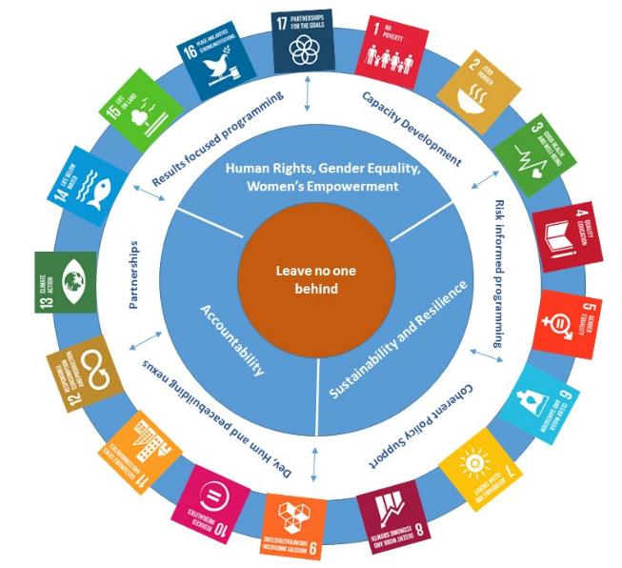
SDGs
Notes:
The 2030 agenda makes clear that development will only be sustainable if its benefits accrue equally to both women and men. It builds on the commitments to respect, protect and fulfil women’s human rights.
It recognizes the indivisibility and interdependence of rights, the interlinkages between gender equality and the social, economic and environmental dimensions of sustainable development, and the need of an integrated approach to implementation.
GEWE is addressed as a goal in its own right (SDG 5), and a catalyst for progress across the entire Agenda and SDGs. Hence integration into other goals and targets to draw attention to the different dimensions of well-being and deprivation women and girls may encounter, and acknowledging the fact that progress across all SDGs will largely depend on the thorough integration of a gender dimension across public policies.
The SDG monitoring report “Turning Promises into Action: Gender Equality in the 2030 Agenda for Sustainable Development” spotlights inequalities and challenges faced by women and identifies gaps and opportunities for gender equality in the 2030 Agenda for Sustainable Development.

Slide 3





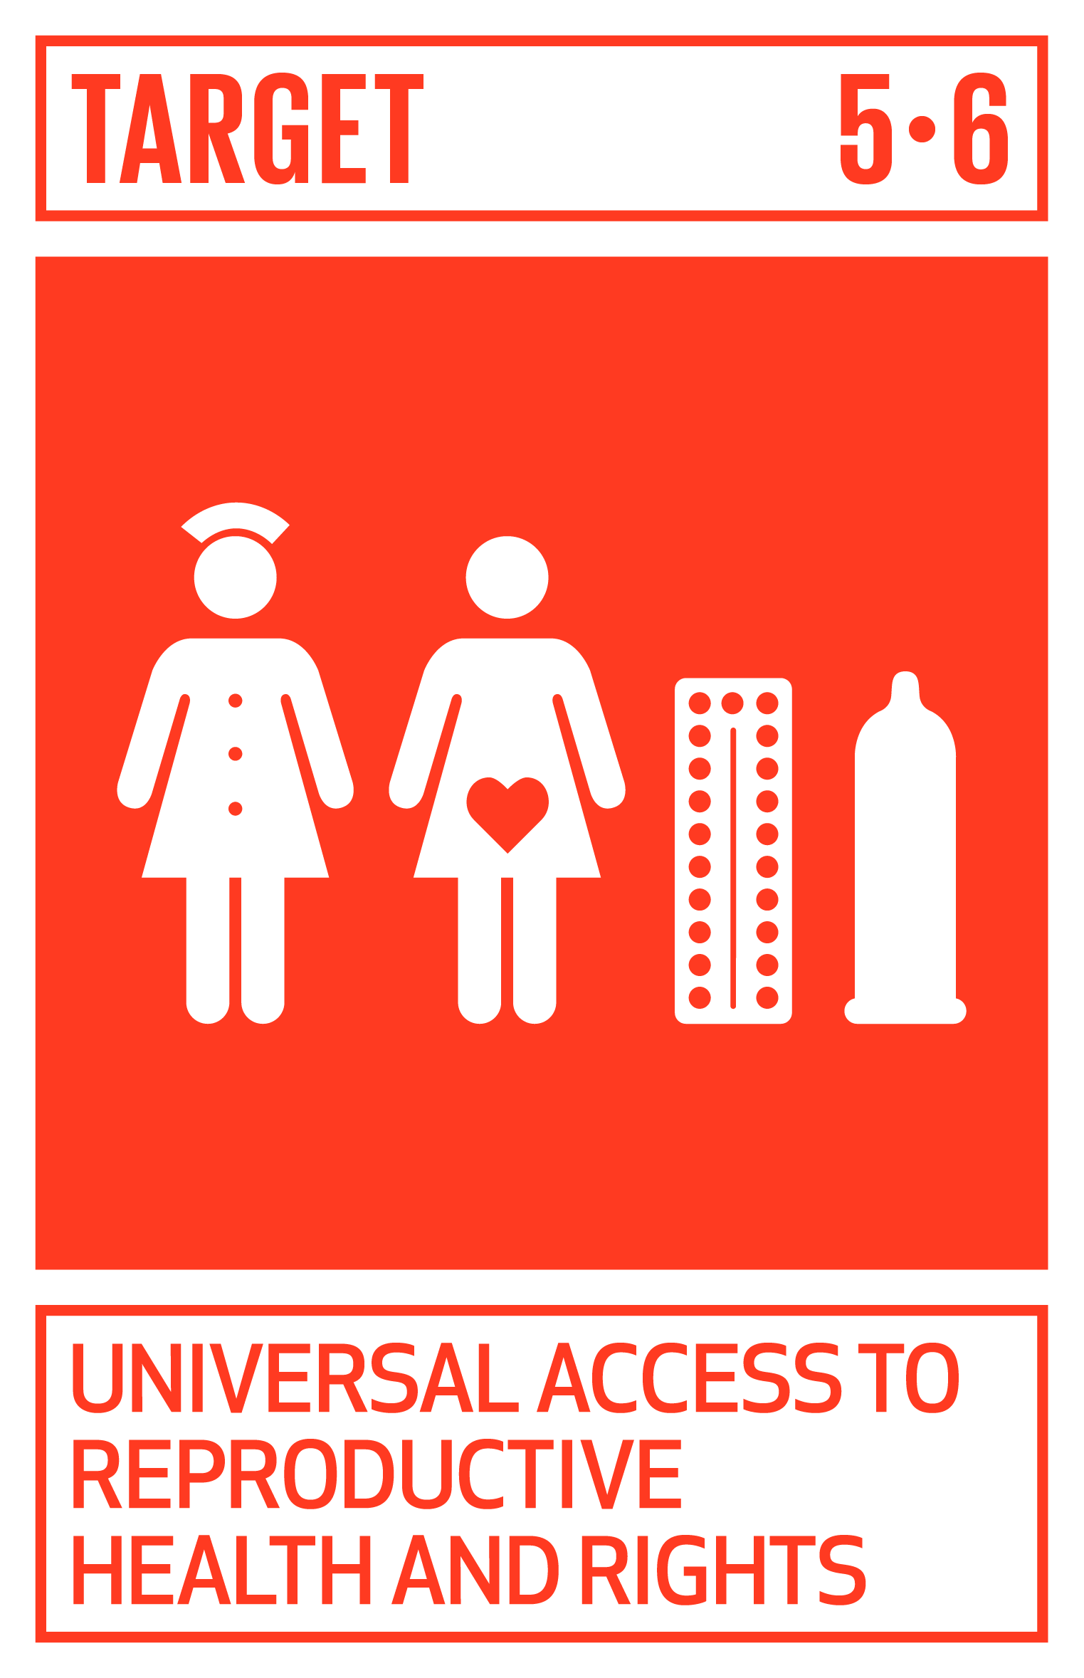



Notes:
SDG 5 on GEWE is a promise to achieve, not just to promote gender equality and the empowerment of women and girls. Its six targets address the structural barriers to women’s enjoyment of their human rights and assure physical integrity and security, voice and choice. Of relevance, the SDG 5 contains a focus on structural change, recognizing that gender equality cannot be achieved unless relationships and systems that shape women’s and girls’ opportunities are also worked upon.
Stand-alone goal 5: “Achieve gender equality and empower all women and girls”:
SDG 5 has nine targets that address many important structural barriers to advancing women’s human rights, namely legal discrimination, violence and harmful practices, unpaid care and domestic work, participation in decision-making, SRHR, and rights to economic resources.

Slide 4
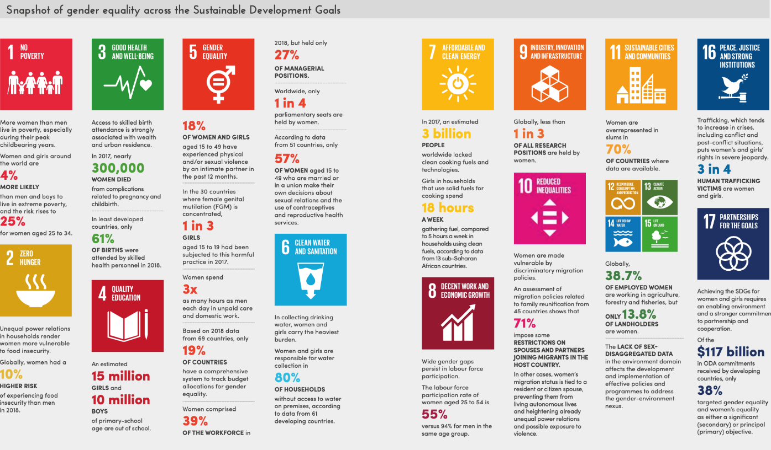
Notes:
In addition to SDG5, targets in other goals cover a comprehensive set of issues, including the gender dimensions of poverty, hunger, health, education, water and sanitation, employment, safe cities and peace and security.
More than 25% of SDG targets explicitly or implicitly address GE & EWG
This is a snapshot of gender equality across the Sustainable Development Goals, from UN Women (2019), Progress on the Sustainable Development Goals.

Slide 5
Leave no One Behind (LNOB)
As we embark on this great collective journey, we pledge that no one will be left behind. Recognizing that the dignity of the human person is fundamental, we wish to see the Goals and targets met for all nations and peoples and for all segments of society. And we will endeavour to reach the furthest behind first.
- SDG Summit Declaration -
LNOB and gender
  Rooted in human rights and the principles of (substantive) equality and non-discrimination;
  Priority to human beings’ dignity and placing progress of the most marginalized communities first – women and girls being all too often at the top of the list.
  Deprivation women and girls experience are extreme when they overlap, hence the largest inequality is the result of overlapping forms of deprivation
Notes:
Leaving no one behind is a foundational principle of and commitment made by 193 UN member states in September 2015 during the adoption of the 2030 Sustainable Agenda.
LNOB entails reaching the poorest of the poor, combat discrimination and rising inequalities, within and among countries, and their root causes. LNOB requires first and foremost an assessment of which people are facing which problems and where. Where are people left behind?
A useful reference on this is the UNSDG Leave no One Behind Guide.

Slide 6
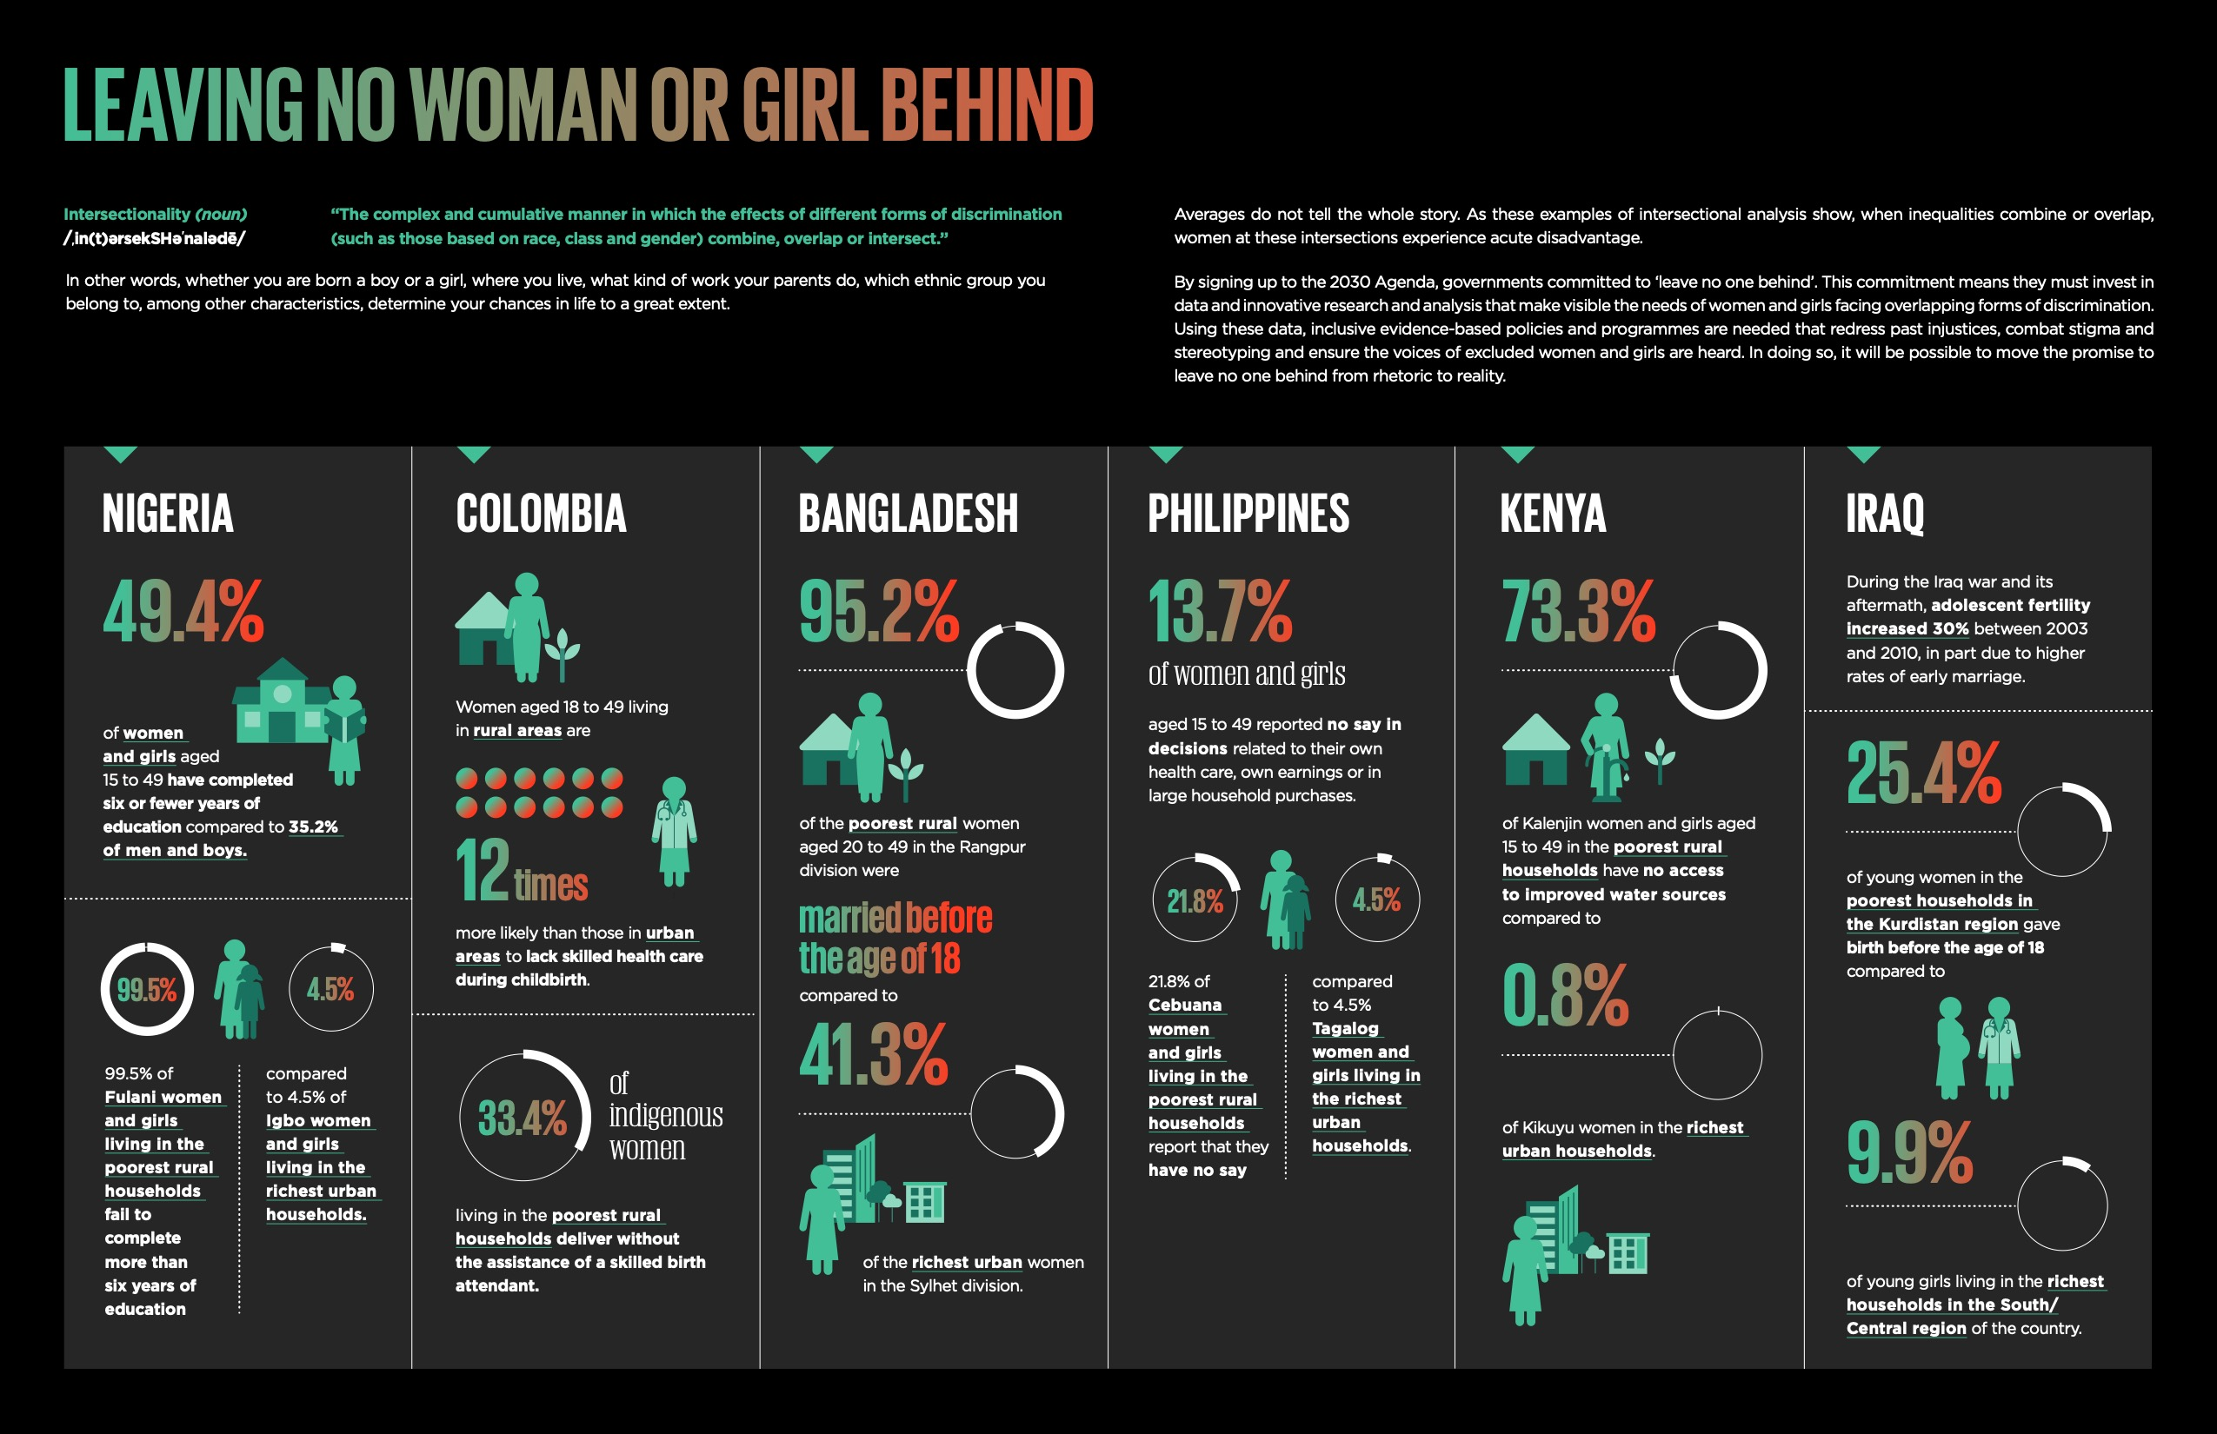
Notes:
Averages do not tell the whole story. As these examples of intersectional analysis show, when inequalities combine or overlap, women at these intersections experience acute disadvantage. Source: Gender Equality: Women’s rights in review 25 years after Beijing.

Slide 7

Gender & SDGs
Recall all SDGs
Choose the one to focus on
Form groups, one per selected SDG
Distribute the handout
Review and discuss relevance for UNODC and from a gender perspective
Form ‘expert groups’ and share the key points with experts from other groups.
Notes:
Explain to participants that the exercise that is about to start is, in line with the discussion you just had, for them to become familiar with the SDGs rationale, targets and indicators, and GEWE within.
Go through the title of each SDG and ask participants to decide in plenary those they would like to work on, provided that some may be particularly relevant in their context.
Divide participants into as many groups as the number of SDGs they decide like to work on. One simple way to do it is to count 1 to x and then assign randomly one SDG to group 1, 2 and so on. Distribute to each group member the M3_2 SDGs and Jigsaw handout with the SDG that has been assigned to the group.
Group members should first read the handout individually and learn about the assigned SDG’s rationale, targets and indicators, and highlight those aspects that are particularly relevant from a gender perspective. Then ask the group to discuss and agree on what is most relevant in their context and from a gender perspective. Allow a max of 30’ for this.
Form temporary ‘expert groups’ by mixing up members of each group. Each expert group should have a representative from the other groups so to ensure coverage of all selected SDGs. Each expert will then be requested to share the points that have been agreed upon in relation to the SDG he/she worked on. Each member should be presenting for a max of 3’.
During both the review and experts’ presentation of the SDGs, facilitator(s) should be floating from group to group observing the process. Should participants be too many, an alternative quicker way of conducting this exercise is to ask one representative from each SDG group to present the key points in plenary and leave time for a brief discussion. This alternative is reasonably shorter as facilitators will be in control of timing, and ensure each presentation won’t take too long.

Slide 8

Questions?
Photo credit: www.flickr.com

