Slide 1
M3
Gender mainstreaming in development programming

Slide 2
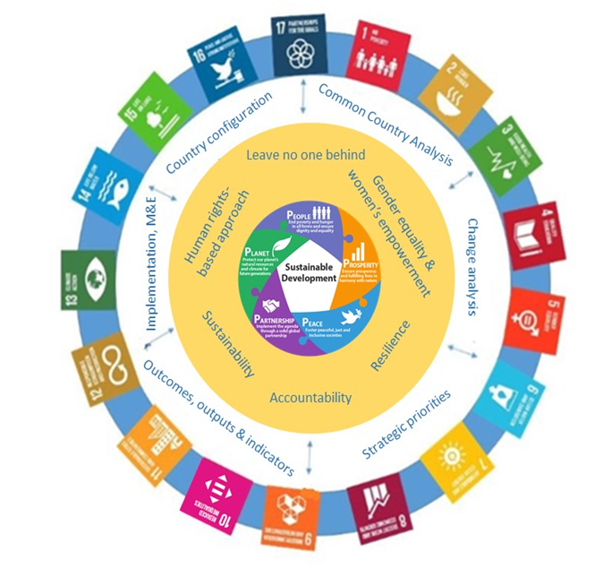
Integrated Multi-dimensional Programming
Notes:
The revitalized Cooperation Framework fully embraces the integrated and multidimensional programming approach that is grounded in the five P’s of the 2030 Agenda: people, prosperity, planet, peace and partnership.

Slide 3
Guiding Principles
Notes:
A companion package for the UNSDCF Guidance has been drafted in 2019 to support the UNCT in the effective application of the six guiding principles underpinning the UNSDCF.

Slide 4
groupwork
Notes:
Divide participants into six groups counting 1 to 6, and assign one principle per group according to the number, i.e. group 1 will work on the human rights-based approach; group 2 on LNOB, and so on.
Ask each group to discuss what the meaning of the assigned principle is and how it could be reflected in the framework of the UNSDCF. Participants could discuss specific issues that should be taken into considerations as well as where to best integrate them in the UNSDCF cycle. Allow 20’ for discussion within the group, and 5’ for each group to share the key points of discussion in plenary.
Should the training be conducted in-country, participants should be asked to contribute concrete aspects of relevance to the specific context where they operate. One example is the human rights standards and approaches that characterize the country

Slide 5
Applying a gender lens
1|
Women’s rights are human rights, and discrimination on the basis of sex is against international human right standards.
2|
Women are disproportionately represented among the most marginalized, discriminated against, excluded, and at risk.
4&5|
Women are both disproportionately impacted by shocks, and key providers of knowledge, agency and collective action to promote sustainability and resilience.
6|
Disaggregating data by sex and other diversities, gender-specific indicators and involvement of women’s rights organizations in monitoring and decision-making, UNCT SWAP-Scorecard on UN accountability to gender equality
Notes:
Of relevance, all of the above principles can also be seen from a gender perspective:
Human rights-based approach: A human rights-based approach is a conceptual framework normatively based on and that integrates international human rights standards and principles in development activities, including women’s human rights and the prohibition of gender-based discrimination. It seeks to analyse inequalities which lie at the heart of development problems and redress discriminatory practices and unjust distributions of power that impede development progress.
Leave no one behind is the core transformative promise of the 2030 Agenda, and the overarching programming principle for all country contexts. It applies to all population groups and is crucial for gender equality as women are usually disproportionately represented among the most marginalized, discriminated against, excluded, and at risk. [ref to the new guidance from UNSDG on the operationalization of the LNOB principle and of resilience]
Gender equality and women’s empowerment are at the heart of sustainable development, and include addressing the root causes of inequalities and discrimination, promoting active and meaningful participation of women and men, and reducing gender inequalities by empowering all women and girls. Gender equality is both a driver and an outcome of sustainable development, and as such needs to feature prominently in all efforts towards it by all relevant stakeholders, including programming at the country level. Also, since gender inequalities manifest themselves in every dimension of sustainable development, concrete and comprehensive efforts are needed across all dimensions to achieve gender equality.
Sustainability and resilience gender equality and women’s participation are key components of social, economic and environmental resilience, disaster risk reduction and sustainability strategies, and sustainable peace building. Women are in fact both disproportionately impacted by shocks, and key providers of knowledge, agency and collective action to promote sustainability and resilience.
Accountability An essential element toward making every woman and girl count includes disaggregating data by sex and other diversities, gender-specific indicators, and the GEM to track the resources allocated to GEWE collectively by the UN system under the UNSDCF cycle, involvement of women’s rights organizations in monitoring and decision-making, while internally the UNCT SWAP-Scorecard (see specific section on this below) is a key element of strengthening UN accountability to gender equality.
Finally, it is important to recall the concept of intersectionality to avoid lumping together women with youth and other vulnerable groups, and better define categories of women who have the potential to be left behind as well as women as agents of change for sustainable development. One risk is in fact to treat women as an homogeneous group and address them only under the "vulnerable" or "marginalised groups” heading or under the LNOB framework. Gender equality is a precondition for the realization of sustainable development and a key sustainable development goal by itself, Goal 5.

Slide 6
Why gender responsive programming
1. It’s the right thing to do:
Gender equality, non-discrimination on the basis of sex and gender identity, and access to sexual and reproductive health and rights are fundamental universal human rights principles
Realizing women’s human rights means:
  recognizing and addressing the underlying and/or immediate causes of women’s and men’s human rights violations;
  challenging structural constraints to the equal rights and choices of women and girls; and
  putting in place appropriate policy and programmatic responses in line with human rights principles.
A human rights-based approach to gender equality also calls for the participation of marginalized, disempowered and discriminated against groups of women and men in decisions that affect their lives, and ensuring they benefit equally from development.
Notes:
Go through the points listed here and in the following slide for participants to be aware of the importance of gender mainstreaming.

Slide 7
Why gender responsive programming
2. It works:
Women equal access to resources and opportunities in agriculture could lead to an increase in agricultural output in developing countries of 2.5-4 percent, with the potential to reduce the number of undernourished people in the world of 12–17 percent, and lifting 100–150 million people out of hunger (FAO, 2011)
Increasing the female employment rates in OECD countries to match that of Sweden, could boost GDP by over USD 6 trillion (PwC, Women in Work Index 2018)
Girls’ education reduces high fertility rates, infant and child mortality, and maternal mortality rates. It increases women’s labour force participation rates and earnings, and fosters investment in children education (UN Women, Progress of the World’s Women 2015-2016)
Diversity in the workforce improves staff performance and productivity; increased innovation, creativity and flexibility; improved understanding and penetration of markets.
Notes:
There is a solid body of research and development work by highly credible sources which demonstrate that reducing gender inequality enhances productivity and leads to more inclusive societies and economic growth. (IMF, 2018 Pursuing Women's Economic Empowerment).
Educational attainments are critical for women’s and girl’s health and wellbeing, as well as their income-generation opportunities and participation in the formal labour market.
Gender diversity is also a key determinant of team’s effectiveness due to its greater assortment of knowledge and skills. Gender diversity makes firms more productive by encouraging creativity idea, attracting more talents, and signalling competent management to investors, among others. (https://hbr.org/2019/02/research-when-gender-diversity-makes-firms-more-productive)

Slide 8

Questions?
Photo credit: www.flickr.com

