Slide 1
M4
UNCT SWAP Gender Equality Scorecard

Slide 2
The UNSDCF cycle
Analysis
Development of the Cooperation Framework
Implementation
Results
National Development Plans
Common Country Analysis
Cooperation Framework Design
UNCT Configuration
Cooperation Framework signed
Funding Framework and SDG Financing Strategy
Agency Specific-Documents
Joint Workplans
Annual Review + One UN Country Results Report
Other Analytic Inputs
Feedback Loop into new cycle
Evaluation Management Response
Cooperation Framework Evaluation
Notes:
Here is the UNSDCF cycle presented at the beginning of this training As mentioned already, the UNSDCF provides a unique opportunity for the integration of GEWE.

Slide 3
Gender-responsive UNSDCF
Analysis
Development of the Cooperation Framework
Implementation
Results
Gender analysis of key national development plans
Gender Equality Profile (sex disaggregated data and analysis)
Conflict analysis (as appropriate)
Inclusive participation of CSO (LNOB)
Mainstreaming Gender in ToC, CF outcomes/outputs/indicators
UN Women collaborative advantage and gender expertise
Funding Framework and SDG Financing Strategy
Agency Specific-Documents
Gender mainstreaming in joint work plans and joint programmes
UNCT SWAP Score Card
BPFA+25 national reports
Thematic KP, research reports, qualitative data, etc.
Flagship reports (Progress, etc.)
Feedback Loop into new cycle
Regular follow up on the management response to evaluation
Guidance and expertise on gender sensitive evaluation and management response
Notes:
Explain that while the UNCT-SWAP Scorecard is listed under the results in the UNSDCF cycle, its indicators actually permeates the whole cycle and it is therefore relevant to discuss it first.

Slide 4

The Structure
1
PLANNING
7
RESULTS
2
PROGRAMMING &
M&E
UNCT-SWAP SCORECARD
6
FINANCIAL RESOURCES
3
PARTNERSHIPS
5
GENDER ARCHITECTURE & CAPACITIES
4
LEADERSHIP & ORGANISATIONAL CULTURE
Notes:
This is how the structure looks like, with 7 dimensions and 15 indicators.

Slide 5
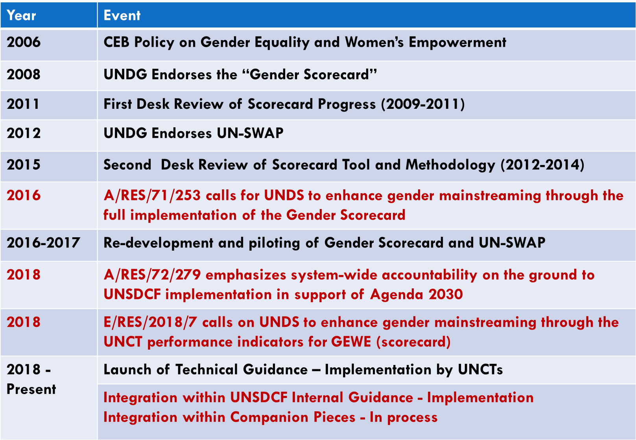
Key milestones
Notes:
The Scorecard is a “whole of UNDS tool” – it is not specific to UN Women. It has evolved since initial evolution; we are now into the second generation, which reflects calls for increasing accountability across the UNDS system, in line with the SDGs.
Strong normative basis – GA RES and ECOSOC.
2006: The Chief Executives Board for Coordination Policy notes: “A United Nations system-wide action plan that includes indicators and timetables, allocation of responsibilities and accountability mechanisms and resources is essential to make the strategy of gender mainstreaming operational.”
UN-SWAP and UNCT GE Scorecard mutually reinforcing
UN-SWAP = Systemwide Action Plan for Gender Equality and the Empowerment of Women
Redevelopment in 2016-2017 to align with the SDGs and the UN-SWAP.

Slide 6
The ‘Scorecard’ within UNDS repositioning
Full implementation of Scorecard mandated by the QCPR
Explicit reference in new UNSDCF internal guidance (and forthcoming Companion Pieces)
Explicit reference in new Management and Accountability Framework for the RC System
Notes:
The below is mostly for background information and does not need to be shared fully with participants. What is important to cite is that the implementation of the Scorecard is mandated by the QCPR and that reference to it can be found in relevant UNSDCF documents.
The QCPR calls upon all UNDS entities to continue to promote GEEW, and for “full implementation of” the UNCT-SWAP GE Scorecard performance indicators, specifying, “in particular with regard to gender-responsive performance management and strategic planning, the collection and use of sex-disaggregated data, reporting and resource tracking, and drawing on available gender expertise in the system at all levels, including in UN Women, to assist in mainstreaming gender equality in the preparation of the United Nations Development Assistance Framework” (now CF).
UNSDCF internal guidance requests for focused integration of GEWE/G throughout the CF (…) putting gender equality at the heart of programming (…) in line with the minimum requirements agreed upon by the United Nations Sustainable Development Group (UNSDG) in the UNCT System-Wide Action Plan (SWAP) Gender Equality Scorecard.”
From draft Management and Accountability Framework (MAF):
RC and UNCT members’ performance assessment systems include performance indicators relating to one or more of the following: communications and outreach on the SDGs, promoting norms and gender equality (drawing on the UNCT SWAP Gender Equality Scorecard).
From CF Internal Guidance – Gender Equality and Women’s Empowerment: Achieving gender equality and empowering all women and girls are integral to realizing the 2030 Agenda and all of the SDGs. To integrate a focus on these issues throughout the Cooperation Framework, UN Development entities should put GEWE at the heart of programming, driving the active and meaningful participation of both women and men, and consistently empowering women and girls, in line with the minimum requirements agreed upon by the United Nations Sustainable Development Group (UNSDG) in the UNCT System-Wide Action Plan (SWAP) Gender Equality Scorecard.”

Slide 7
What is reporting used for?
Inform UNSDCF design/implementation and identify opportunities for enhancing gender mainstreaming
Include results in UN INFO (in process)
SG reports on QCPR implementation and on Gender Mainstreaming in the UN System
Notes:
Ideally, the initial assessment should take place in advance of the UNSDCF design and implementation (come back to UNSDCF later).
UN Info = web-based planning, monitoring and reporting platform that digitizes the UNDAF/CF and joint work plans at country level. Roll-out to 32 UNCTs took place in 2018 and is progressively expanding to the rest of UNCTs in 2019-2020. More on this will be presented in a webinar in DAY 3.

Slide 8
Scorecard implementation
Rapid, participatory self-assessment by inter-agency team vis-à-vis 15 indicators across 7 dimensions
Internal or external facilitation/coordination
Evidence-based, relying on internal consultation and analysis
Action planning based on findings
Ongoing monitoring to track progress, incl. annual reports

Slide 9
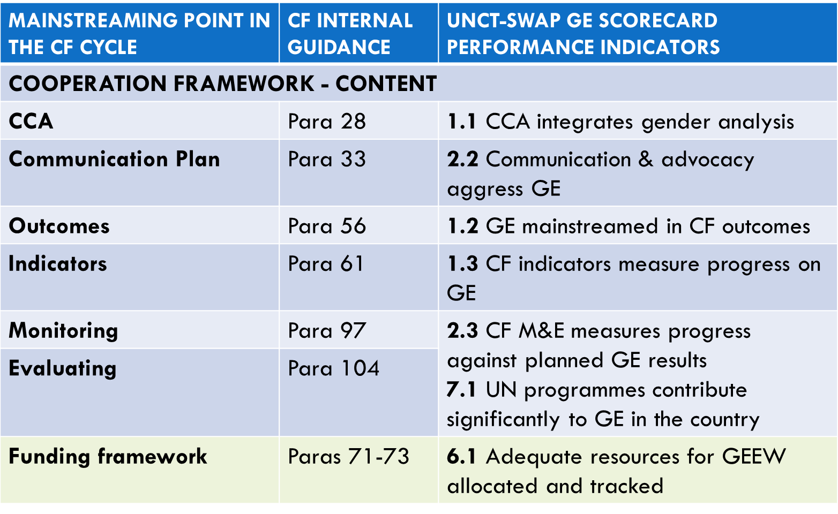
Utilizing the Scorecard to mainstream gender into the UNSDCF cycle
Notes:
GE Scorecard supportive of “hardwiring” GE into the CF and its implementation.

Slide 10
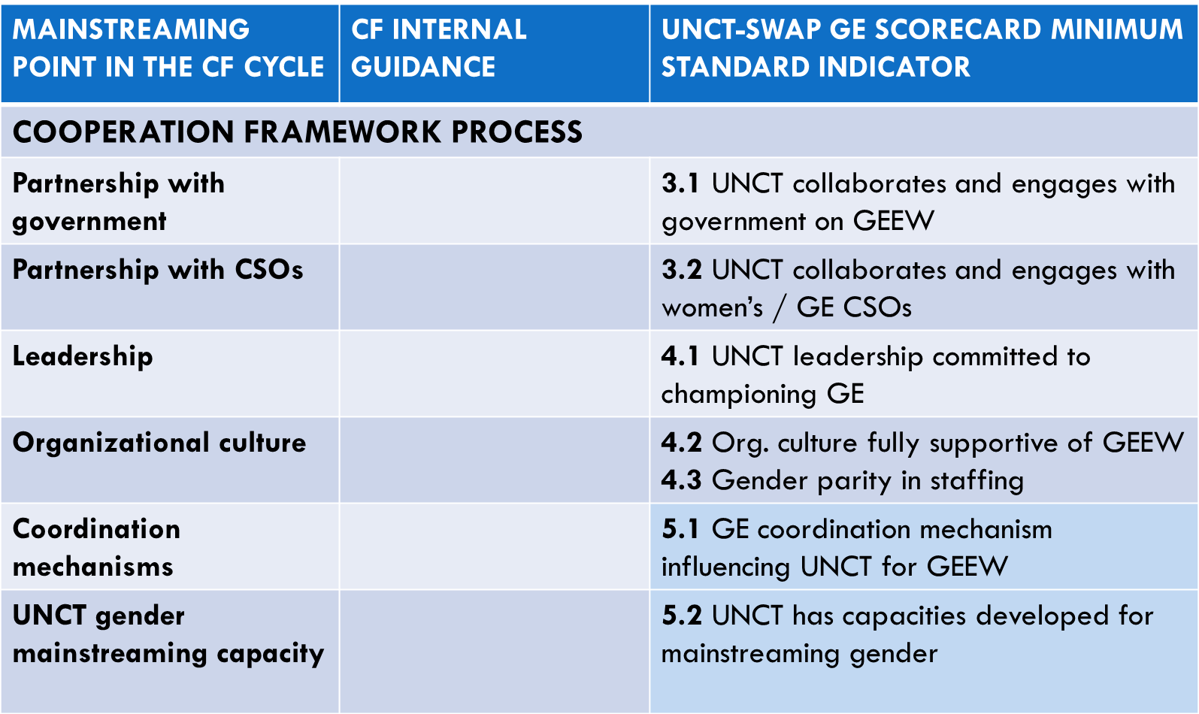
Utilizing the Scorecard to mainstream gender into the UNSDCF cycle

Slide 11
Support to UNCTs
Technical Guidance designed to support self-assessment
Global Gender Scorecard Helpdesk genderscorecard.helpdesk@unwomen.org
Database of Scorecard consultants
Dedicated training of UNCTs focal points (44 already trained for reporting in 2019 – more trainings to follow in 2020)
Notes:
These are the available resources that can support in undertaking the scorecard, including in relation to the UNSDCF.

Slide 12

Questions?
Photo credit: www.flickr.com

