Slide 1
M4
Country Gender Equality Profiles and Briefs (CGEPs/CGEBs)
Notes:
The adoption of the 2030 Agenda for Sustainable Development and its accompanying Sustainable Development Goals (SDGs) requires renewed efforts by UN Member States to measure economic, social and environmental progress under the global agenda from a gender equality and women’s empowerment perspective.
The Country Gender Equality Profiles are one contribution UN Women is making to increased knowledge and analysis of GEWE at the country level.

Slide 2
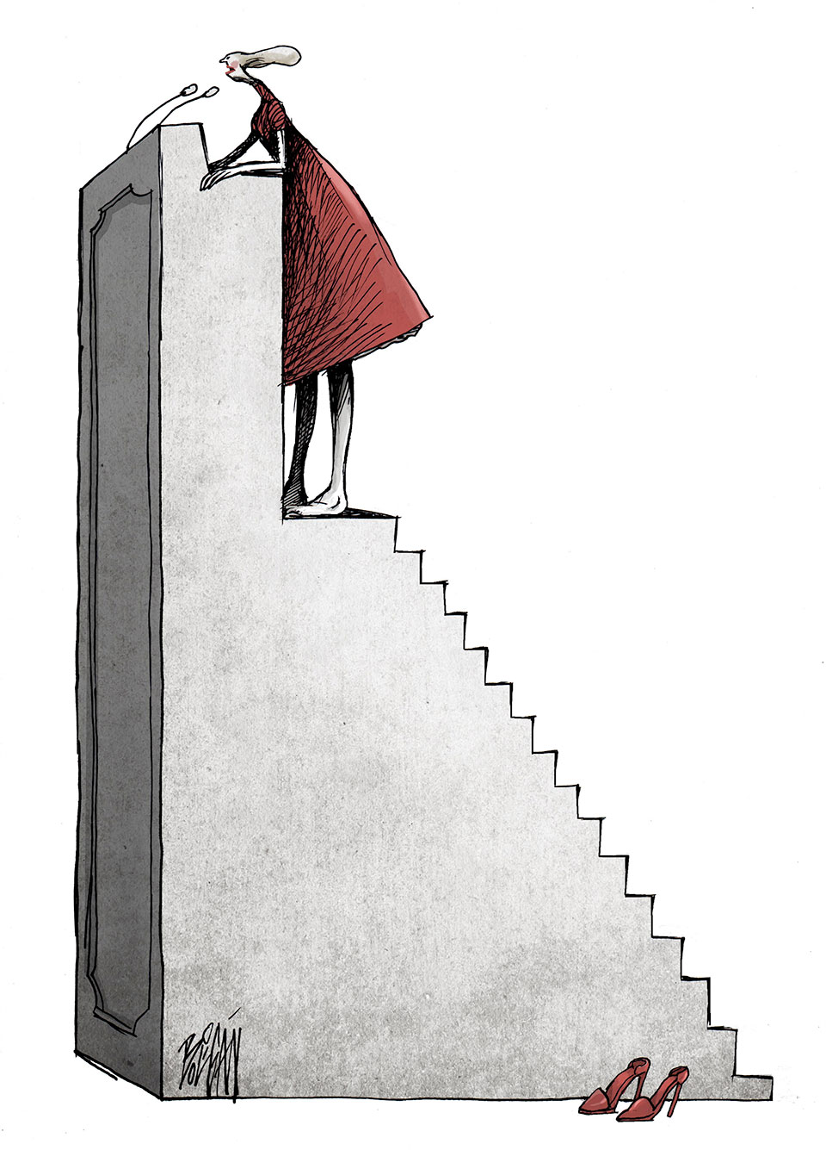
Strengthening of National Gender/Women’ Machinery
UN Partnership and Coordination
Inclusion & representation of Civil Society
Advocacy
Leveraging UNW partnerships
LNOB
Credit: Angel Boligan, Cuba
Notes:
CGEPs are one of a series of knowledge and planning/ accountability tools to support enhanced gender mainstreaming by UNCTs. The others are the new UNCT-SWAP Gender Equality Scorecard, as well as the updated Resource Book on Mainstreaming Gender Equality in UN Common Programming at the Country Level and Resource Guide for UNCT Gender Theme Groups.
The process for the development of the CGPEs is in and on itself a contribution to a more gender-responsive UNSDCF engagement. It aims to leverage and strengthen the role and leadership of the national women’s machinery (NWM)/national mechanism for gender equality and the empowerment of women as a key player in guiding and monitoring implementation of commitments to GEWE.
Built with the participation of civil society organizations, including marginalized groups most at risk of being left behind when realizing the tenets. To be updated as soon as a similar tool will be developed with reference to the UNSDC.

Slide 3
What’s is in the CGEPs?
Core principles: international norms and standards, of national ownership and of increased UN coherence and gender mainstreaming
Combination of quantitative & qualitative analysis
Findings and recommendations for policy reform (concluding observations CEDAW committee, PFA national reviews, UPR recommendations)
Focus on closing national statistical gaps
nuanced qualitative analysis (political, social and economic situation, legislative analysis, policy analysis, political analysis)
Notes:
The nuanced qualitative analysis includes GEWE issues framed against international norms and standards; policies that impact on GEWE; specific analysis of laws and policies aimed at addressing different aspects of GEWE.

Slide 4
Gender Equality Briefs
Report template
UN Women owned
Desk review
Quality Assurance
Notes:
Gender Equality Briefs are an alternative where CGEPs are not possible. These are developed following a desk review of relevant information, are structured following a specific template, but they are UNW-owned documents. Mostly used for shaping UN Women programmes, they could also serve the UNCT to inform the situation in any given country on GEWE issues, for e.g. legislation/policies, leadership, violence against women, etc.
Examples of countries where CGEPs/CGEBs were used to directly inform UNSDCF are Armenia and Belarus.

Slide 5
Linkages with SDGs/UNSDCF
CGEPs
Voluntary National Reviews
MAPS
CCA
Notes:
CGEPs are critical contributors to the CCA and should be developed before the CCA process starts. To date, CGEPs are available developed for xxx (facilitators to check whether CGEPs/CGEBs are available for the country/region.
Besides efforts at the country-level, other important UN Women contributions to supporting the implementation and monitoring of the SDG include:
First global monitoring report on the SDGs, Turning Promises into Action: Gender Equality in the 2030 Agenda for Sustainable Development
UN Women flagship programme on gender statistics, Making Every Woman and Girl Count (Women Count)
Joint global programme with WHO to improve statistics on violence
In addition, the UNDP human development report, and other UN agencies’ gender profiles/context analyses may contribute important information to the CCA.

Slide 6
Data for CGEPs and GE Briefs
National data sources
Data disaggregation (sex, income, ethnicity, race, migration status, disabilities, geographical location, etc.)
Indicators for specific groups (women-girls)
Missing data: partnerships with other agencies

Slide 7
Some good practices
Xxx here to indicate and showcase some existing good practices (Alicia to contribute, best if something visual to break a bit the monotony of presentation of group exercises)
Notes:
A marketplace showcasing existing good practices on either CCAs that have a strong gender analysis or CGEPs/CGEBs that were used to directly inform the UNSDCF could be organized here. Also, good examples of CGEPs globally should be shared.
Among the examples provided of CCAs with a solid gender analysis are Georgia, Armenia and Kosovo

Slide 8

Questions?
Photo credit: www.flickr.com

