Slide 1
M4
GEWE in the development phase
Notes:
Let’s now move to other stage of the UNSDCF cycle.

Slide 2
Module Objectives
Identify the entry points for gender mainstreaming in the UNSDCF cycle and actions to be taken;
Draw on all the resources presented and leverage on the momentum for the integration of gender in their context;
Harness the potential of the UNCT SWAP Gender Equality Scorecard to ensure a gender-responsive UNSDCF engagement;
Directly apply the inputs and considerations made during the training when developing the UNSDCF
Notes:
Before doing so, it is however important to recall the key objectives of the module, which will end with an overview of some additional tools of relevance for the development of the UNSDCF.

Slide 3
Gender-responsive UNSDCF
Analysis
Development of the Cooperation Framework
Implementation
Results
Gender analysis of key national development plans
Gender Equality Profile (sex disaggregated data and analysis)
Conflict analysis (as appropriate)
Inclusive participation of CSO (LNOB)
Mainstreaming Gender in ToC, CF outcomes/outputs/indicators
UN Women collaborative advantage and gender expertise
Funding Framework and SDG Financing Strategy
Agency Specific-Documents
Gender mainstreaming in joint work plans and joint programmes
UNCT SWAP Score Card
BPFA+25 national reports
Thematic KP, research reports, qualitative data, etc.
Flagship reports (Progress, etc.)
Feedback Loop into new cycle
Regular follow up on the management response to evaluation
Guidance and expertise on gender sensitive evaluation and management response
Notes:
It is also important to recall the different stages of the UNSDCF and what should be done to make them gender-responsive.
More specifically, what we are going to discuss under the development and later the implementation and results stages is: gender-responsive outputs, outcomes and indicators; the gender marker in relation to the UNSDCF financing, and the UNCT-SWAP Gender Equality Scorecard.

Slide 4
Entry Points
UNSDCF Process
GEWE Actions
Common Country Analysis
Gender Analysis
Theory of Change
Engender the Theory of Change
UNSCF Development
Gender-responsive Outputs, Outcomes, Indicators
Results
Programme on Gender
Notes:
Again, this slide is once again to recall the key entry points and related GEWE Actions.

Slide 5
Minimum requirements
Ensure gender expertise during the development of the cooperation framework.
Identify priorities on gender equality and the empowerment of women and girls, and integrate them into national development plans, legislation and frameworks.
Apply a multiple-track strategy for gender mainstreaming with dedicated outcomes, targets and indicators designed to address gender inequality. [indicator 1.3 UNCT-SWAP Gender Equality Scorecard]
Reflect gender-based and intersectoral forms of discrimination in the development of outcomes and outputs. Ensure at least one gender-targeted outcome, and the integration of gender-equality considerations into all outcomes. [indicator 1.2 UNCT-SWAP Gender Equality Scorecard]
Ensure disaggregation of Indicators by sex and age; and that 33 percent of the indicators measure changes in gender equality and women’s empowerment, in line with SDG targets, including SDG 5. [indicator 1.3 UNCT-SWAP Gender Equality Scorecard]
Notes:
Here are some of the actions that should be taken to ensure the development of the UNSDCF is gender-responsive.
Among the good practices to date, Mexico provides a good example of integration of GEWE expertise during drafting of the cooperation framework.
Reference to relevant Scorecard indicators is also included.

Slide 6
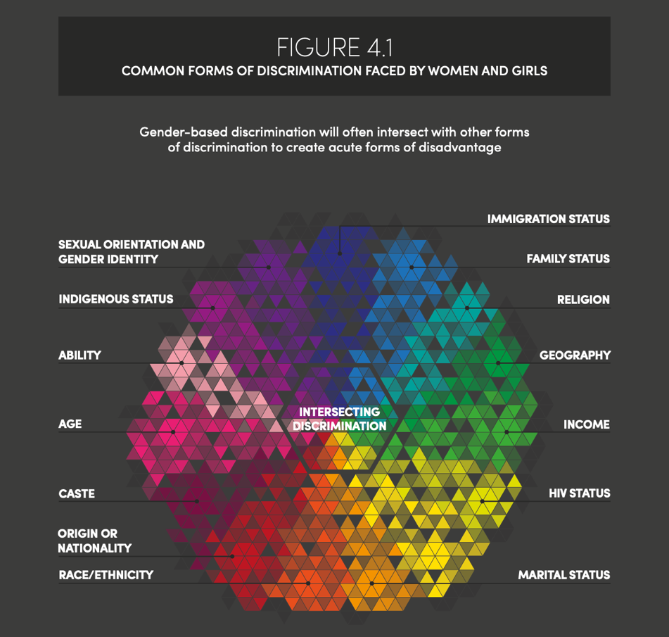
INTERSECTIONALITY
Notes:
This figure is taken from the 2018 UN Women SDGs Progress Report – Turning Promising into Actions, to illustrate that disadvantage is intensified for women and girls living at the intersection of inequalities and discrimination. Intersectionality is defined as “the interaction of multiple identities and experiences of exclusion and subordination.”

Slide 7

Gender-responsive Results-Based Management
Gender-responsive RBM makes sure gender equality is a key component of the process of achieving the desired result.
A gender-responsive results chain is a coherent sequence of elements (each of which has a different function in the result chain) to improve gender equality.
Results-based and gender-responsive management provides a clear vision of the desired impacts of our programme on gender equality.
Notes:
Let’s now focus on gender-responsive outputs, outcomes, and indicators. Similarly to what we normally do for a project or a programme, for the development of UNSDCF to be gender-responsive a GEWE perspective should be integrated throughout the process for the achievement of the desired result, from the input to the activity, to the output to the outcome.
The great opportunity provided by the CF also lies in its timeframe, which is 3-5 years, which allows for longer outcomes and impact to be achieved and measured.

Slide 8
The Results Chain
institutions or people do
a) something differently (behavioural change) or
b) something better (change in performance)
influence, but largely beyond the control of the programme
timeframe: during or up to a few years after programme
actions taken to transform inputs into outputs
HIGH LEVEL OF CONTROL
LOW LEVEL OF CONTROL
RESULTS
INPUTS
ACTIVITIES
OUTPUTS
OUTCOME
IMPACT
a group of people or an organization has improved capacities, abilities, skills, systems, or if something is built, created or repaired as a direct result of the programme
are under the control of your organization and its partners
timeframe: during programme
long-term effects of a programme
broader than the programme;
programme only contributes to it
timeframe: typically 2- 5 years after programme ends
resources needed to carry out activities
Notes:
THE RESULTS CHAIN
Go through the elements of the results chain from bottom up (from inputs to activities, to outputs, to outcomes, and to impact). Then focus on the outcomes and outputs as main areas for UNSDCF.
OUTPUTS
An output of a programme or project is delivered if a group of people or an organization has improved capacities, abilities, skills, systems, or if something is created, built or repaired. Outputs are achieved as a direct result of an entity’s support. Outputs are typically the result of a number of completed activities. Outputs are delivered during the implementation of an intervention.
A feature that distinguishes outputs from outcomes (the more ‘distant’ results) is that they are still largely under the control of the organizations involved.
OUTCOME
An outcome of a programme or project is a result that reflects the way institutions or people do
a) something differently (behavioural change) or
b) something better (change in performance)
The key difference is that, unlike outputs here the organizations involved have an influence over achieving an outcome, but achieving the outcome ultimately goes beyond their control.
However, if properly defined (and not too high-level), the outcome should still be realistically, and outcomes are typically achieved at the end or even after the intervention has been implemented.
IMPACT
Impact is a description of the long-term effect(s). It implies a change in people’s lives. Impact typically relates to economic, social, cultural, institutional, environmental, technological changes in the lives of a target population.
The impact should be related to the Sustainable Development Goals, internationally agreed development goals, national development goals (as well as human rights enshrined in constitutions), and national commitments to international conventions and treaties like the CEDAW.
Impact is typically much broader than the intervention. Usually, we can establish no more than the extent to which the intervention contributes to an impact.
RESULTS
This leads us to a definition of results: The UN defines ‘results’ as outputs, outcomes and impact. And most importantly, results are NOT inputs or activities.

Slide 9
Applying a gender lens
 | Definition | Gender questions
Impact | Highest order objective, it represents the longer-term change that the intervention intends to contribute to. | Is gender equality one of the overall objectives the intervention aims to contribute to? Are women and men of different ages and diverse background going to benefit equally from the longer-term change?
Outcome | Describes the short and medium-term effects of the intervention. | Does the outcome include any clear reference to men and women, boys and girls, of various background and existing inequalities between them? Does the intervention have the potential to improve women’s access to resources, services, technologies, training and employment opportunities?
Notes:
These are a few exemplary questions that should guide the integration of a GEWE perspective in the results chain.

Slide 10
Applying a gender lens
 | Definition | Gender questions
Outputs | Outputs describe what the intervention intends to deliver in order to achieve the Outcome. These are the results that the intervention must deliver. | Do the outputs respond to the different needs and priorities of men and women (across age and background), as identified by the gender analysis? Do the outputs challenge/redress existing gender inequalities and discriminatory norms and practices?
Activities | Activities describe what actions will be undertaken to achieve each output. | Are women and men provided with equal opportunities to plan, participate and monitor the project’s activities? Do the planned activities take into account the roles and responsibilities of women and men, in order to ensure equal opportunities for and benefits from participation?
The Impact and Outcome statements might not need to mention gender explicitly, but the gender equality dimensions must be reflected in indicators, baselines, targets, means of verifications, assumptions and risks;
On the other hand, Outputs and Activities need to be specific and clarify how the project intends to respond to women and men’s different needs, priorities and constraints identified

Slide 11
Group Exercise ctd.
Go back to your original grouping, i.e. political, social, economic, justice and violence, environmental
Based on the gender analysis and the work done for engendering the theory of change, formulate:
  Two outcomes, with at last one gender-specific and the other reflecting gender considerations
  Two outputs
  One activity per output
Notes:
Again, the best way to understand how it could play out in your context, is for participants to try it themselves.
Ask participants to go back to the grouping used in DAY TWO for engendering the theory of change.
This exercise is a continuation of the previous one to contribute another important piece, namely gender-responsive outcomes and outputs.
Read instructions aloud and allow a max of 30’ per group to work on the outcomes, outputs, and activities.
Distribute post-it of different colours and shape for use for the outcomes, outputs and activities.
Ask participants to write each on separate post-it and to place them along a path towards the desired change.

Slide 12
Some examples of gender-responsive outcomes
Outcome 1: By 2024, vulnerable populations, including women, children, adolescents and youth, have more equitable access to quality basic social services, according to their age and gender-specific needs, including in humanitarian situations (UN Women Mali)
Notes:
Examples of strategic priorities and gender-responsive Result Frameworks to be shared. Pending availability, one exercise could be to show outcome on one screen and ask participants in plenary to indicate if gender-responsive or blind and if latter, to reformulate to make it gender-responsive.

Slide 13

Credit: Un Women, Turning Promises into Actions
Notes:
As for the indicators, it is important to remember that the SDG targets and indicators are now “the default monitoring framework” of the UNSDCF and are informed by country-defined and disaggregated baselines, thus the need reflected in the UNSDCF.
Here is a list of the gender-sensitive indicators across all SDG. Ensuring UNSDCF indicators are gender-sensitive and track gender-related changes over time and across all outcome areas. For example Uzbekistan UNSDCF has a large number of gender-responsive indicators.
Addressing challenges to systematic gender-responsive monitoring such as uneven coverage of gender indicators across goals and targets and uneven availability of gender statistics across countries.
Ensuring capacity on gender-sensitive M&E during the UNSDCF cycle.
Within this, UN Women is the custodian agency to monitor three Tier II SDG indicators: indicator 5.1.1 Legal frameworks that promote, enforce and monitor GEWE; indicator 5.5.1 Proportion of seats held by women in national parliaments; indicator 5.c.1 Proportion of countries with systems to track and make public allocations for gender equality and women's empowerment Currently, only 10 out of 54 gender-related indicators can reliably be monitored at the global level. UN WOMEN (2018) Turning Promises into Action.

Slide 14

Questions?
Photo credit: www.flickr.com

